Slide 1
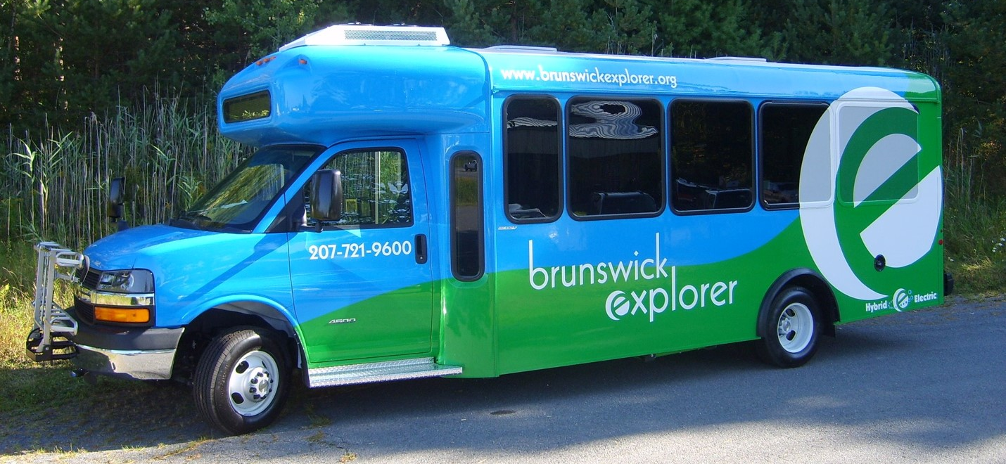
Final Plan
BRUNSWICK TRANSIT STUDY
April 2021
Notes:
Welcome –
Thank you for joining us tonight for the public meeting regarding a transit study that is currently underway for the Town of Brunswick.
The Town of Brunswick and MaineDOT are jointly sponsoring a public transit study; the purpose of the study is to complete a comprehensive review of the local transit networks’ performance, assess the unmet transit needs and develop recommendations for improved service.
The public will be included in the transit study process during all phases of the project and will have ample opportunities to provide feedback and comments to the team. It is the intention of the team to engage in a broad conversation with the community through a number of venues – surveys, public meetings and written comments.
As an initial step to gathering public input, a public survey was conducted and made available on both the Town’s website and the project website, www.brunswicktransitstudy.com/get-involved.
The survey was closed on August 15th and the results of that survey will be discussed tonight; there is time allocated for public questions/comments later in this meeting tonight. Although the survey was closed-out to be able to obtain initial results and feedback for tonight’s meeting, the survey can still be taken by those interested parties. The transit study team will accept feedback during the entirety of the transit study process.
Before we get started with the presentation, I would like to provide a little background on the team conducting the study. Following a Request for Proposal process conducted in the Spring of 2020, the DOT and the Town hired the transportation/transit consultant team of AECOM and Fitzgerald & Halliday (FHI) to conduct the transit study. AECOM is National infrastructure consulting firm with extensive experience internationally, nationally and locally here in Maine and in the Mid-coast Region. FHI is a multi-disciplinary firm with expertise in transportation, sustainability, and community planning and engagement.

Slide 2
Guiding Principles
Streamline the bus route
Maintain or improve frequency of service (currently every hour along the main part of the route)
Assume a 2-bus weekday system, but also look at possible future expansion options
Meet other services when possible (BREEZ, BlueLine, Downeaster, Concord Coach)
Serve Brunswick Landing on every trip

Slide 3
Comments from Respondents
“I feel very strongly about adding regular service to Brunswick Landing to help weave it into the fabric of Brunswick, increase Rec Center use, and support the new residences and businesses there.”
“I like expanding the bus route around Pegasus and Brunswick Landing. It would be easier to mothers with children and other car-less residents to use the Explorer.”

Slide 4
Ranked Preferences of Respondents
Provide all day service to Brunswick Landing
Maintain hourly trip frequency
Expand service earlier and/or later in the day
Add service to Maplewood Manor
Higher Priority
Lower priority

Slide 5
Transition to Fixed Route Operation
Direct, reliable service between stops
Every stop is served more times per day, all day
Passengers access service through established bus stops
No need to call ahead to request service
Expands the service day earlier and later
Connects with BREEZ to allow commuting to/from Portland
Maintains or improves hourly frequency

Slide 6
Transition to Fixed Route Operation
Requires ADA paratransit
Van service for eligible riders
Within ¾ mile of fixed route available during the same operating hours
Requires use of an additional vehicle and part-time driver
Requires ADA eligibility office support
Requires rides to be scheduled in advance

Slide 7
Transition to Fixed Route Operation
Additional annual cost
Requires 4.0 full-time equivalent (FTE), as compared to 3.5 FTE now
Total annual operating cost increases from $298,000 to $325,000; additional annual cost to the Town would be $10,000
Town contribution for 2020-2021 was $81,000
Additional one-time costs for bus stop signs, etc., to be covered by the Town; approximately $5,000

Slide 8
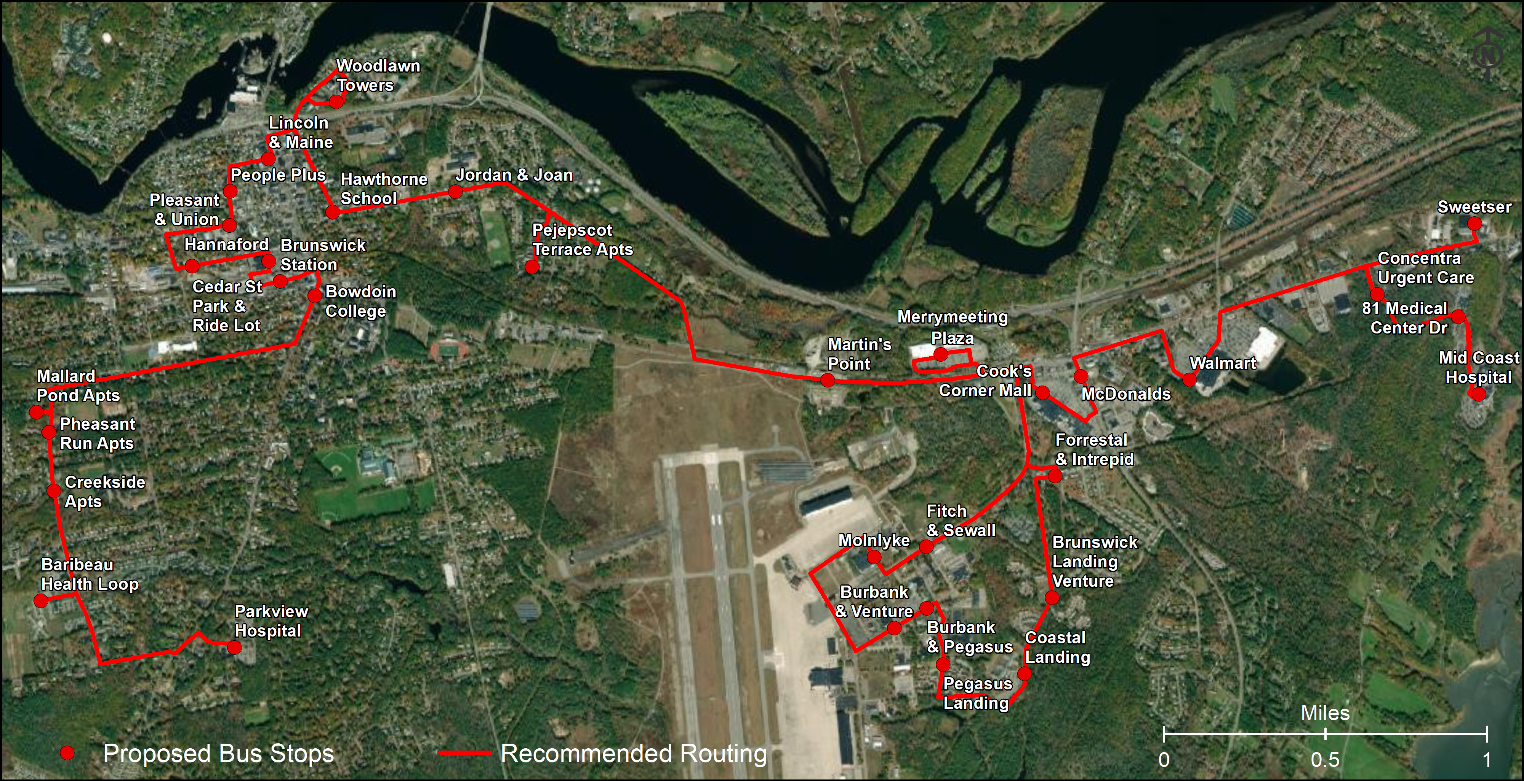

Slide 9
Other Considerations
New buses will be procured as soon as practicable
Expand the span of service based on public feedback
Currently 7 AM – 4:30 PM on weekdays
Modify driver shifts to allow additional hours in the morning and evening
Allows meaningful work-day connections to the BREEZ
Allows work trips within Brunswick too (7-3, 8-4, 9-5, 10-6)
Re-brand the service to build excitement about the new faster, more direct, convenient, community-focused local service
Bus stop signs and informational materials need to be designed, purchased, and installed/distributed by the Town
Consider options for future expansion

Slide 10
Frequency and Expanded Service Hours
AM
PM
5 | 6 | 7 | 8 | 9 | 10 | 11 | 12 | 1 | 2 | 3 | 4 | 5 | 6
Current
Proposed
Bus
Departure
Meet the 6:45 AM Southbound BREEZ
Meet the 6:22 PM Northbound BREEZ

Slide 11

Re-Branding Discussion
Brunswick Circulator
Brunswick Area Shuttle Service (BASS)
Brunswick Area Bus Service (BABS)
Brunswick Local Area Shuttle Track (BLAST)
Brunswick Link (BLINK)

Slide 12
Longer-Term Options
Add a third vehicle to the service
1 additional transit vehicle, would need to procure a vehicle
Additional $90,000/year in total operating cost; local share would be around $34,000
Options available with a third transit vehicle
Split into two routes with more frequent service on Bath Road
Serve Bay Bridge Estates and Maplewood Manor on every other trip
Serve additional destinations on Gurnet Road: Perryman Drive, Ward Circle, Cluf Bay Road
Add limited weekend service
Saturday service: $60,000/year in total operating cost; local share would be around $23,000; no additional vehicles needed
Assumes deviated fixed route service with 2 vehicles for 8 hours
Would require additional drivers to fill shifts
1 additional driver; would go from 4.0 FTE to 5.0 FTE

Slide 13
2021
Implementation Plan
Spring
Re-Name/Re-Brand the Service
Develop the Funding Plan
Finalize the Span of Service
Develop a Bus Stop Plan
Finalize the New ADA Service Plan
Procure Bus Stop Signs
Take Delivery of the New Vehicles and Apply New Branding
Coordinate schedules with METRO BREEZ, Amtrak Downeaster, and BlueLine
Finalize the New Schedule
Develop Communications Materials
Install Bus Stop Signs
Launch the New Service
Finalize/Test the New Route
WMTS
Town
Town / MDOT / WMTS
Town / WMTS
Summer
Town
Town / WMTS
Town
MDOT / WMTS
Fall
Town / WMTS
Town / WMTS
Town / WMTS
Town
Town / WMTS

Slide 14
Next Steps
Finalize funding plan
Develop marketing plan/new branding scheme
Finalize implementation plan
Implement new and rebranded service in 2021

